Slide 1
Edge Advanced Mediation
Extensions

Slide 2
Extend with Programming
Notes:
** so far all requests are always going to the backend

Slide 3
Extreme Flexibility with Extension policies
When you need more flexibility than supported by the out-of-the box policies, Edge has the ability for a developer to use server-side JavaScript or Java or Python.
External libraries can be included at the organization level or via proxy. This is defined with <IncludeURL> defined in the policy.
Execution time limits available in policy to avoid infinite loop or slow performing code.
Notes:
ADDED: overview of capabilities of extension policies
- use of include for including 3rd party libraries
- use of resources at org/env level so 3rd party libraries don’t have to be included in proxy bundle but yet are still resolved
- controlling extension policy

Slide 4
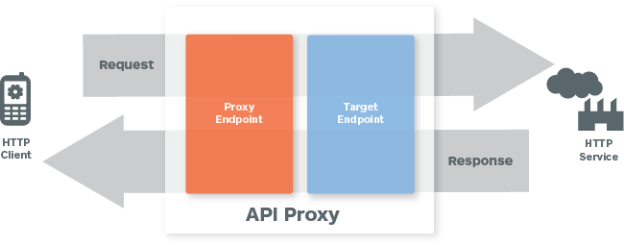
JavaScript Object Model
Context
A context object (context) is created for each request/response. Within the context, you can access variables and the HTTP message.
Methods
getVariable(), setVariable() – context.getVariable(“myVar”);
Messages Objects
request, response
proxyRequest, proxyResponse,
targetRequest, targetResponse
Notes:
http://apigee.com/docs/api-services/content/javascript-object-model

Slide 5
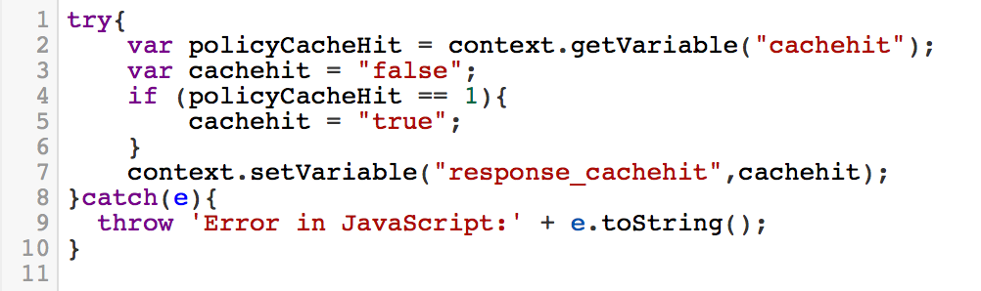
JavaScript Overview
Allows you to run server-side JavaScript to extend the capability of proxy processing. Important when needing to use loops/switches/complex logic.
Preferred choice of callout amongst developers
Can be used to leverage asynchronous httpclient requests
Relies on Rhino
Edge uses E4X, extending capability for XML support

Slide 6
JavaScript Object Model (cont’d)
Message Object Properties
The HTTP message objects contain properties for each part of the HTTP Message:
headers
queryParameters
method
body/content
Notes:
http://apigee.com/docs/api-services/content/javascript-object-model

Slide 7
JavaScript httpClient
The JavaScript http client can be used to make asynchronous http requests.
Two methods exposed:
get()
send()
Each method returns an exchange object that exposes additional methods:
isError()
isSuccess()
isComplete()
waitForComplete()
getResponse()
getError()
Notes:
http://apigee.com/docs/api-services/content/javascript-object-model

Slide 8
Java Callout
Same principle as JavaScript, but using the java programming language. Java is typically used when needing extreme performance with complex logic.
Not available in free Edge organizations.
Relies on two libraries:
expressions-1.0.0.jar
message-flow-1.0.0.jar
https://github.com/apigee/api-platform-samples/tree/master/doc-samples/java-cookbook
Network I/O, file system read/writes, current user info, process list, and CPU/memory utilization are not permitted by the security model.
Notes:
http://apigee.com/docs/api-services/content/customize-api-using-java

Slide 9
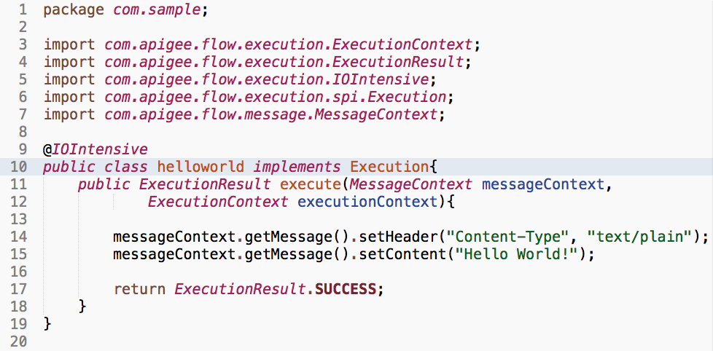
Java Callout (cont’d)
Be sure to import the necessary Edge libraries. When compiling the jar for upload into Edge, however, do *not* include these as they already exist within the platform.
Notes:
http://apigee.com/docs/api-services/content/customize-api-using-java

Slide 10
Python Script
The Python Script policy lets you add customized Python functionality to your API proxy flow, especially when the functionality you need is beyond what the Edge out-of-the-box policies provide
Not available in free Edge organizations and available in Edge Enterprise plan only
Network I/O, file system read/writes, current user info, process list, and CPU/memory utilization are not permitted by the security model.
<?xml version="1.0" encoding="UTF-8" standalone="yes"?>
<Script name="Python-1">
<DisplayName>Python-1</DisplayName>
<ResourceURL>py://myscript.py</ResourceURL>
</Script>
import base64
username = flow.getVariable("request.formparam.client_id")
pwd= flow.getVariable("request.formparam.client_secret")
base64string = base64.encodestring('%s:%s' % (username, pwd))[:-1]
authorization = "Basic "+base64string
flow.setVariable("authorizationParam",authorization)
Notes:
http://apigee.com/docs/api-services/content/customize-api-using-java

Slide 11
Choosing Which Extension Policy to Use…
Use built-in policies first and foremost (when possible)
Use JavaScript:
mashing up responses/manipulating json and non-complex XML
looping /switching through datasets
if it’s more intuitive than Edge policies (for example, when setting target.url for many different URI routing combinations)
Most preferred option for Edge developers
Use Java/Python:
if performance is the highest priority
when the solution requires functionality that is best served in Java (e.g. email notification service)
Notes:
http://apigee.com/docs/gateway-services/content/best-practices-api-proxy-design-and-development
ADD: section on choosing extension policy vs. out of the box policy

Slide 12
THANK YOU

